Slide 1
Exception handling
C++
Present By:- Uzma Banu

Slide 2
Introduction
Exception handling in C++ is a mechanism that allows a program to handle runtime errors in a controlled and graceful manner. When a program encounters an exceptional situation, such as a division by zero, accessing an invalid memory location, or a file not found, it can throw an exception. Exception handling provides a way to separate error-handling code from the regular flow of the program.
Exception handling in C++ consist of three keywords :- 1.try
2.throw
3.catch

Slide 3
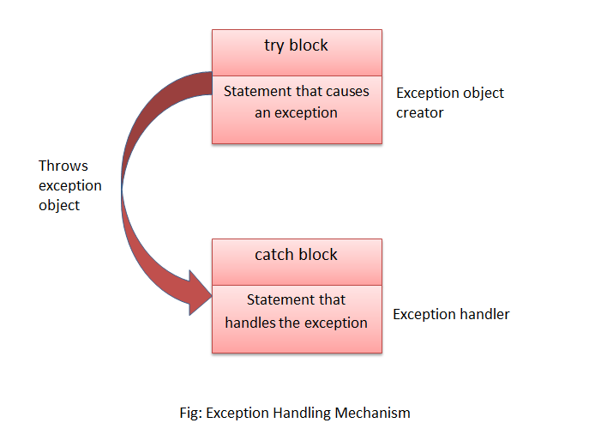
Fig:- Exception Handling

Slide 4
Try keywords
try − A try block identifies a block of code for which particular exceptions will be activated. It's followed by one or more catch blocks.
Syntax:-
try { // Block of code to try }

Slide 5
throw keywords
It is used to throw exceptions to exception handler i.e. it is used to communicate information about error. A throw expression accepts one parameter and that parameter is passed to handler.
throw statement is used when we explicitly want an exception to occur, then we can use throw statement to throw or generate that exception.
Syntax:-
try { // Block of code to try
throw parameter; }

Slide 6
catch keyword
catch block is intended to catch the error and handle the exception condition. We can have multiple catch blocks to handle different types of exception and perform different actions when the exceptions occur.
Syntax:-
catch() { // Block of code to handle errors }

Slide 7
Program
#include <iostream>
using namespace std;
int main()
{
int a=10, b=0, c;
// try block activates exception handling
try
{
if(b==0)
{
// throw custom exception
throw "Division by zero not possible";
c = a/b;
}
}
catch(const char* ex) // catches exception
{
cout<<ex;
}
return 0;
}

Slide 8
Output
Division by zero not possible

Slide 9
Benefits
Error Identification: Exception handling helps identify and categorize errors in code.
Maintainability: It enhances code maintainability by separating error-handling logic from regular code.
Robustness: Applications become more robust as exceptions prevent unexpected failures.
Debugging: Facilitates easier debugging by providing detailed error information.
Security: Improves security by preventing unintended vulnerabilities.
Scalability: Aids in building scalable applications by handling errors systematically.

Slide 10
Thanks…!

